Slide 1
Review OQC pickup sample & chop stamp
1
Current procedure from PCS → FA → OQC → SCM
OQC pick up & Return sample
PCS issue Pro plan
Production plan
Pick up sample
Reading barcode Inner/Outer 1st
Weight check 1st
OQC Normal inspection
Reading barcode Product / Inner
Weight check 2nd
Reading barcode Inner/Outer 2nd
Return to Pallet
①
②
③
④
⑤
⑦
⑧
⑨
⑩
SCM shortage
FA confirm stock
Reliability
inspection
⑥
OQC chop stamp
Report daily
Chop stamp physical all lots
Find all lots same model, shift, Line
Record Pallet ID & S/N carton
Matching Pallet ID & Outer carton box
Find Pallet ID&F/G
⑯
⑮
⑭
⑬
⑫
⑪
FA/SCM
FA
warehouse
FA
ID pallet
Scan ID pallet to receive by PDA
Confirm receiving by WMS
⑰
⑱
⑲
⑳
Current situation:
Pickup & Return sample → Manual Job at process: ① ~ ⑦
Chop stamp: Loss time to find pallet → Manual Job at process: ⑪ ~ ⑯
Need to improve

Slide 2
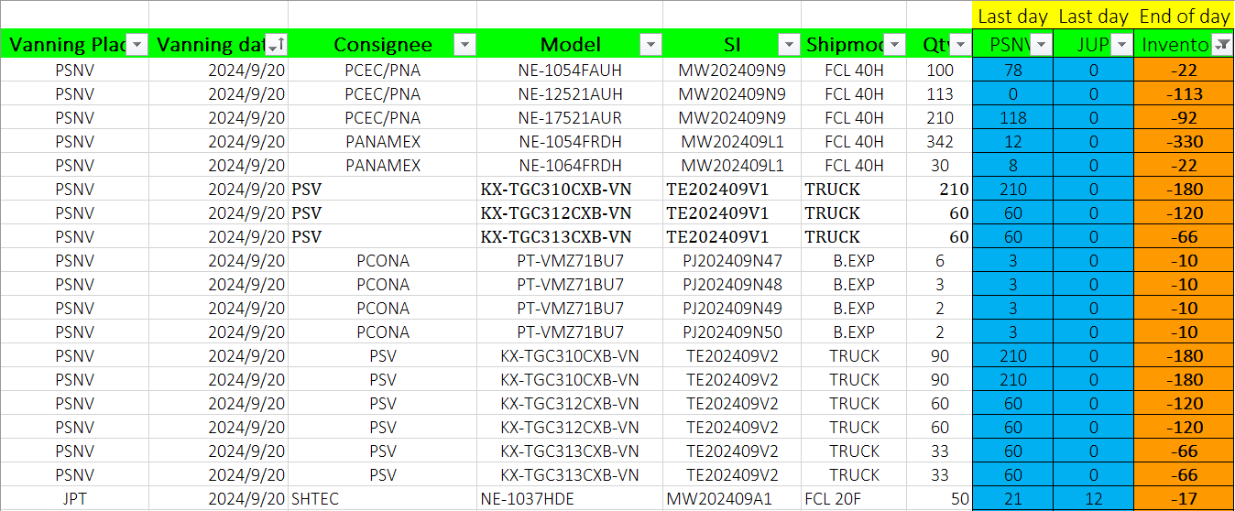
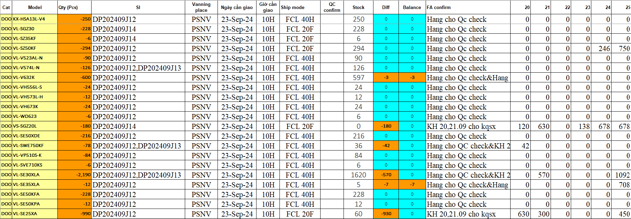
① Confirm shortage shipment
2
OQC confirm shipment plan to focus priority shipment models
◆ Current
◆ Proposal
Step 1: SCM send inventory & shipment plan
System will display details:
Indicate priority shipment model to announce OQC inspection
Indicate details shipment plan: Time, Board/Air
Indicate stock Q'ty, shipment Q’ty
How to control minus product: when re-running
In case production plan be changed --> How to control ?
Step 2: FA update inventory & shipment plan
Step 3: OQC input shipment information to focus check priority
Using time: 5 mins/day*4 BD/BU =20 mins/day
Save time: 20 mins/day

Slide 3
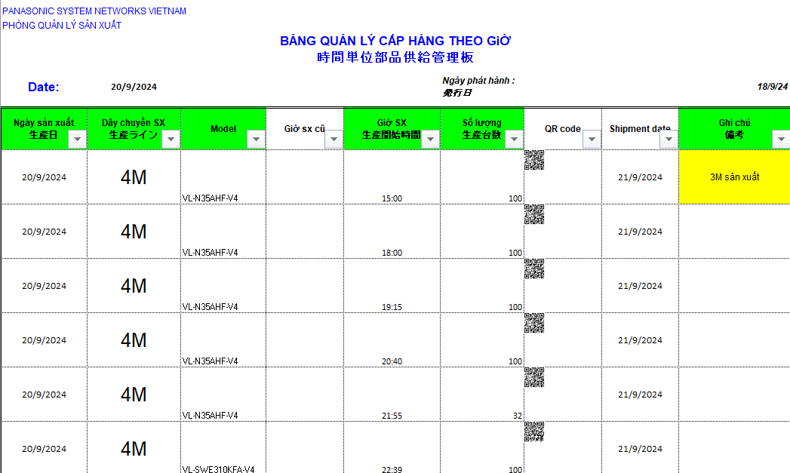
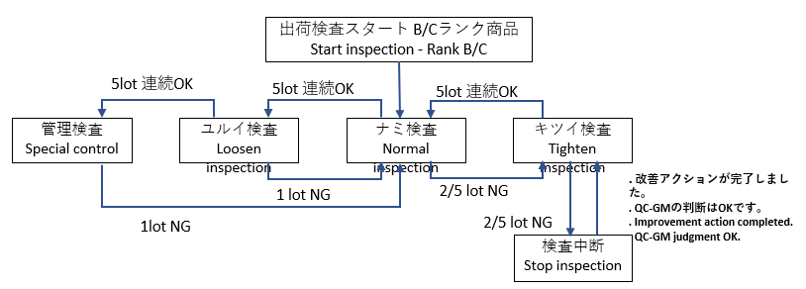
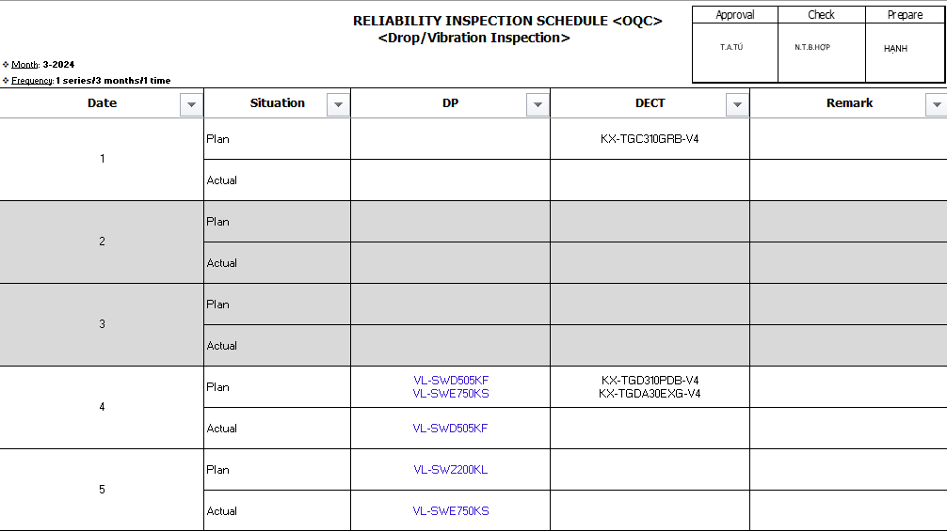
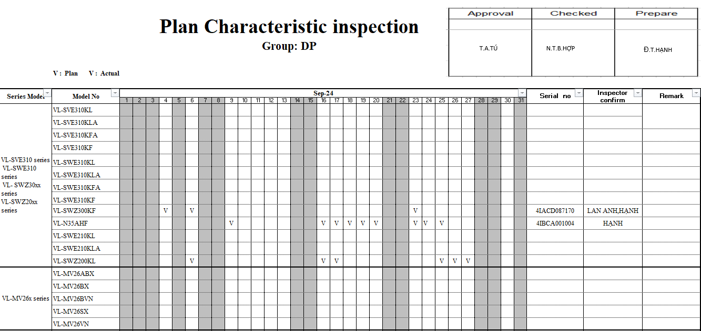
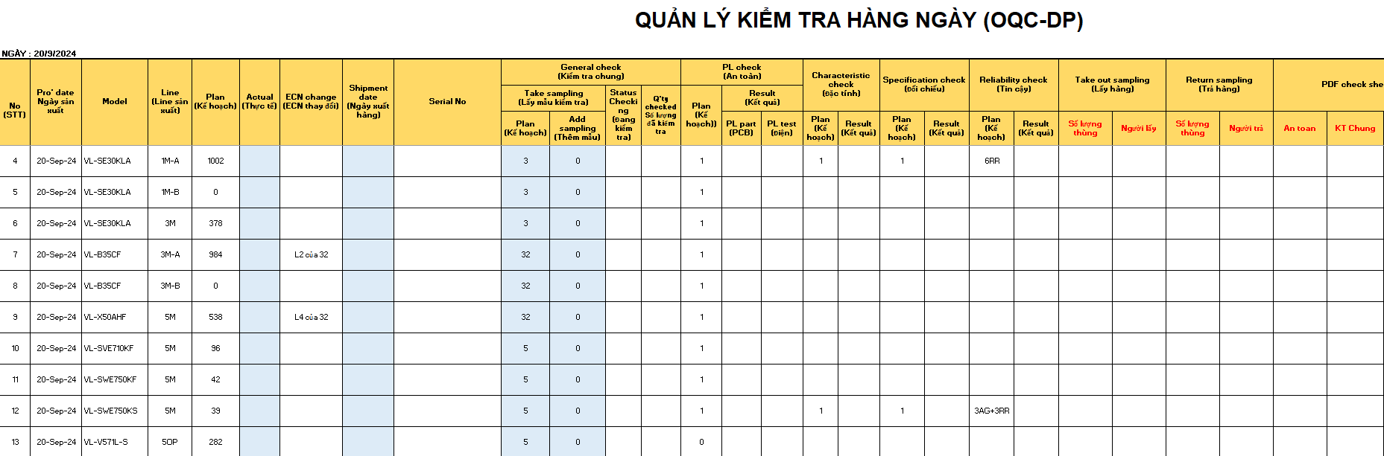
① OQC re-make production plan
3
OQC making production plan base on production plan that PCS send
◆ Current
◆ Proposal
Step 1: PCS send Daily production plan <Email/Server>
Step1: OQC make database: Sample Q’ty; Characteristic/Reliability plan
Standard
Plan
Plan
Testing Frequency:
Characteristics/Specification : 1pcs/series model/month
Reliability test: 3pcs/series model/3 months
Step 2: OQC copy into OQC format to control
System will be linked with OQC Inspection plan and indicate details:
OQC sampling Q’ty
Assign model that will be Reliability test
Auto change sample Q’ty level (Ex: Normal level → Loosen level)
OQC re-making production base on information of PCS:
Add some information: Sample Q’ty, PL, Characteristic, Reliability, Specification…
➔ Using time: 10 mins/day
System will link with OQC inspection plan and auto update:
➔ Save time: 10 mins/day

Slide 4
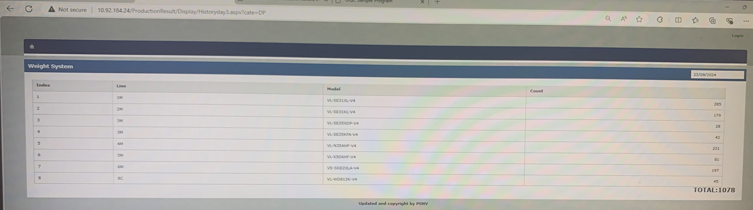
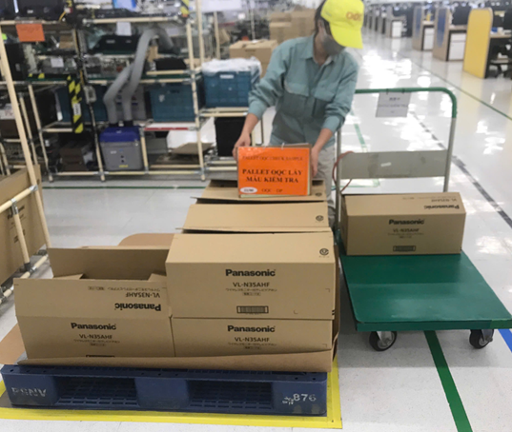
② OQC pick up sample
4
OQC pick up sample follow serial range
◆ Current
◆ Proposal
Step 1: Access Portal to confirm Production result
System can be indicated:
Scan barcode of product → Displayed OQC sample Q'ty (System auto indicate sample Q’ty
Indicate lot number (Auto change sample level)
Reminder the time to pick up sample: Divide Serial No range to pick up sample
Step 2: Divide serial range to Pick up sample at Pallet on FA line
Dect
DP
Dect
Pick up outer box and put indication
Pick up inner box and put indication
Using time: 1mins*8 times/day=8 mins/day
Save: 8 mins/day

Slide 5
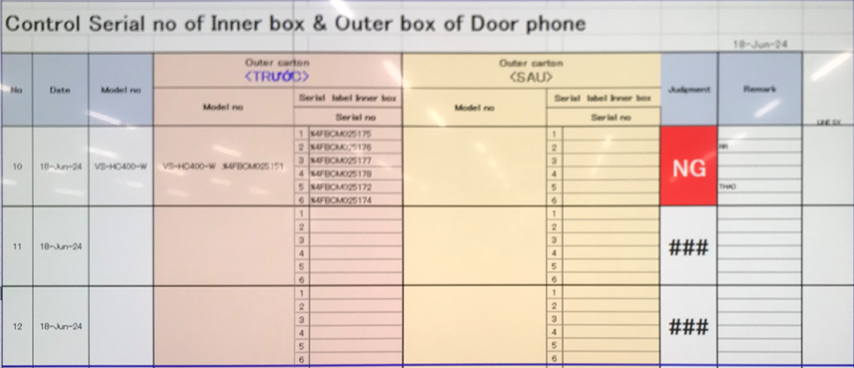
③ Reading barcode Inner/Outer 1st time
5
Confirm Outer carton and inner box
◆ Current
◆ Proposal
Reading Barcode of Outer box and Inner box
Purpose: To confirm Outer box includes how many inner box and which serial No
System link weight check system to confirm Outer box includes which inner boxes
Using time: 30lots*10sec*2Outer boxes=10mins/day
Save: 10 mins/day

Slide 6
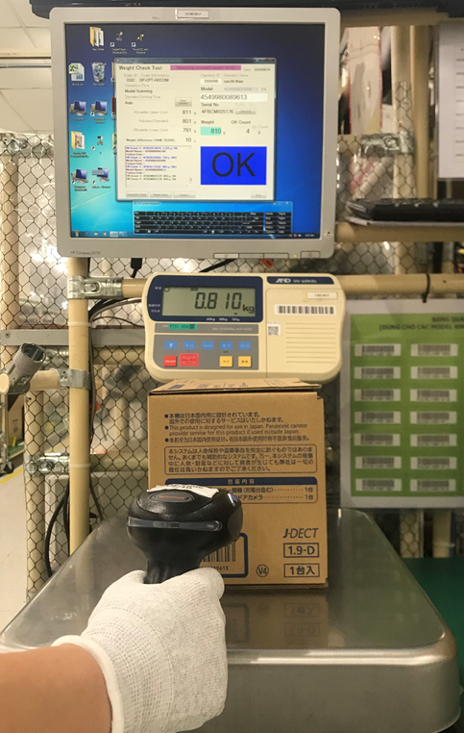
④ Weight check 1st time
6
Weight check offline at OQC to confirm accessory
◆ Current
◆ Proposal
Weight check 1st time:
Purpose: To confirm full inner box before un-packing
System link weight check system to weight of inner box
➔ Weight already recorded weight of inner box
➔ No need do weight check 1st at OQC
Using time: 150pcs*5sec*2 BD/BU=24mins/day
Save: 24 mins/day

Slide 7
⑤ OQC Normal inspection
7
OQC normal inspection
◆ Current
◆ Proposal
Current inspection procedure
System link with Database sample Q’ty:
OQC make Database sampling of model → System auto link to Database to indicate sampling Q’ty of model
After finish inspection → System indicate result of each serial No → Matching sample Q’ty with database to indicate changing situation
Confirm the number of samples to be taken
Appearance check
Function check
Manual confirm sample Q’ty enough or not

Slide 8
⑥ Reliability inspection
8
Reliability inspection:
◆ Current
◆ Proposal
Current inspection procedure
System link with Database sample Q’ty:
Confirm checking plan of characteristic, specification, reliability
OQC make Database about grouping series model need to check Characteristic, Reliability ➔ System auto select model and remind to inspect
Limit Q’ty of model to be suitable with OQC lead time
System alarm if inspect duplicated serial No
Basic function check: Power ON check
Inspect: Characteristic, Specification, Reliability
Full function check
Indicate result in OQC control sheet

Slide 9
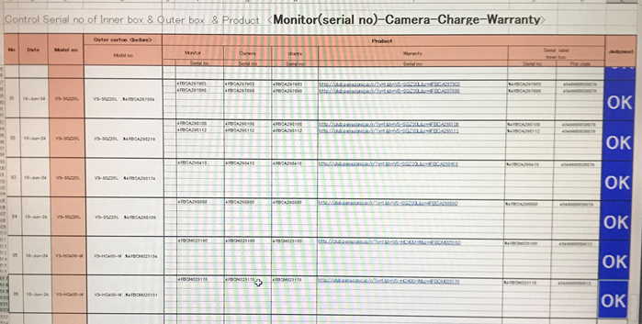
⑦ Reading barcode Product Inner to confirm correct serial No
9
Confirm ingredients of product for ensure matching serial No
◆ Current
◆ Proposal
Reading barcode Product Inner to confirm correct serial No
Reading barcode Product Inner to confirm correct serial No
OQC make master list product ingredients: Monitor, camera, wireless, charger…
System can auto indicate ingredients must read barcode

Slide 10
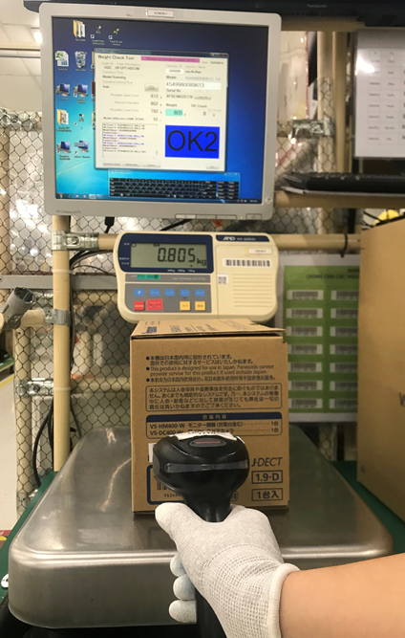
⑧ Weight check 2nd time
10
Current procedure from PCS → OQC → FA → SCM
◆ Current
◆ Proposal
Weight check 2nd time:
Purpose: To confirm full inner box after packing, compare weight check 1st time & 2nd time for judgment
Weight check 2nd time: Auto link with weight check system of FA to compare weight of inner box and Judgment
FA weight check system
Link

Slide 11
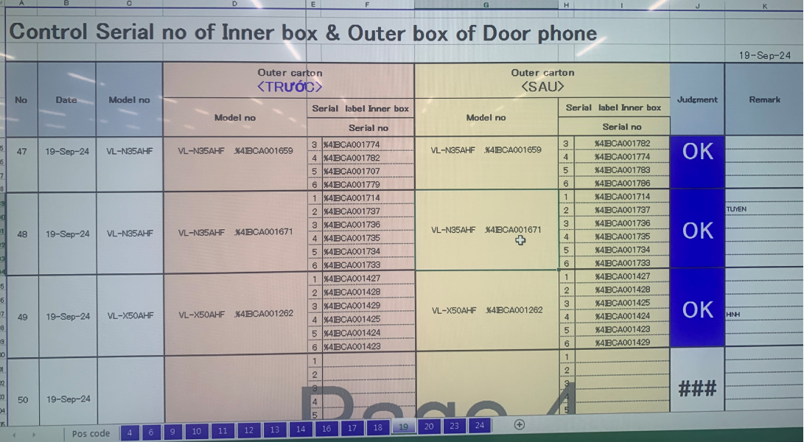
⑨ Reading barcode Inner/Outer 2nd time
11
Confirm matching Outer box with inner box
◆ Current
◆ Proposal
Reading barcode Outer & Inner 2nd time
Purpose: Ensure correct Outer box & Inner box
System auto link with FA weight check system
Scan ID outer → Auto link with FA weight check to compare Outer box & inner box
FA weight check system
Link

Slide 12
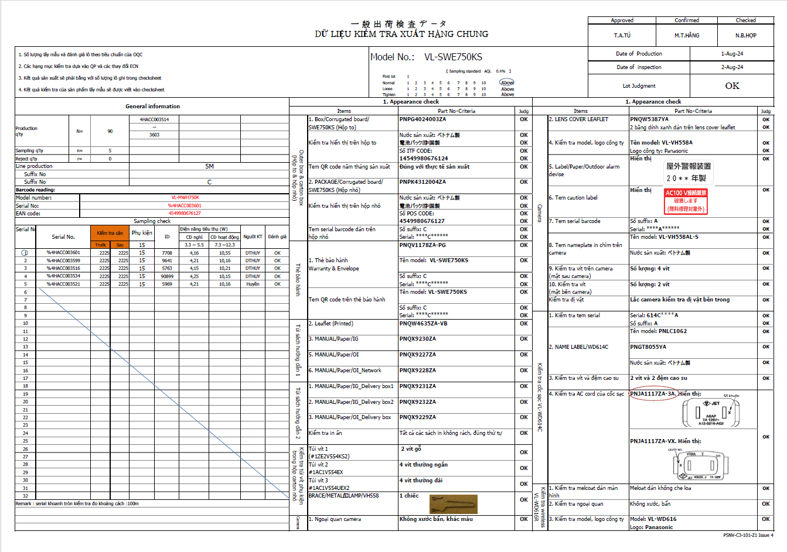
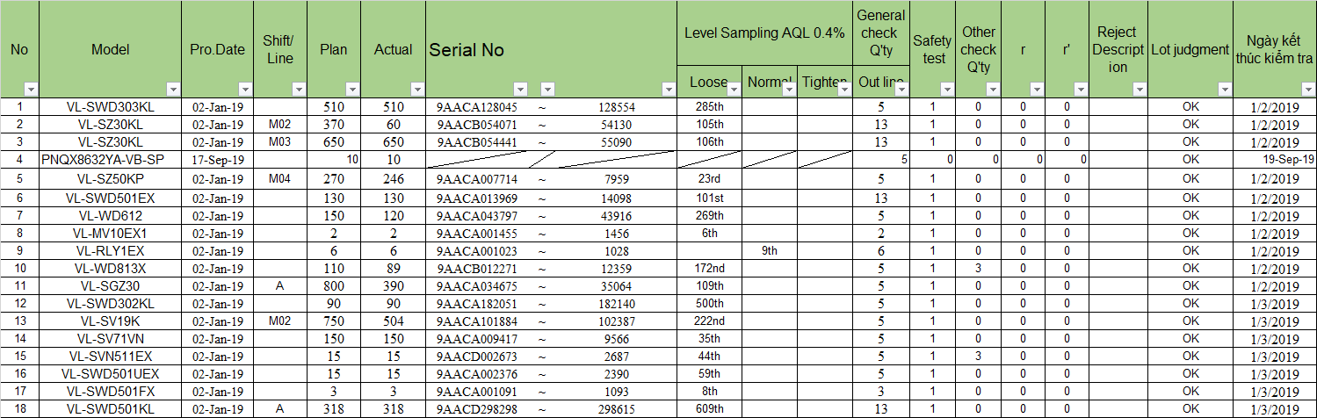
⑯ Output check sheet inspection & Report
12
Record OQC inspection check sheet and report
◆ Current
◆ Proposal
Current situation:
System auto output OQC inspection result
Manual making OQC inspection check sheet:
System auto output: Production Q’ty, Serial range, FA line, Production date, OQC sample serial No, Inspection date, Sample Q’ty
Manual input summary OQC inspection result:
➔ Using time: 10 mins/day
➔Save time: 10 mins/day

Slide 13
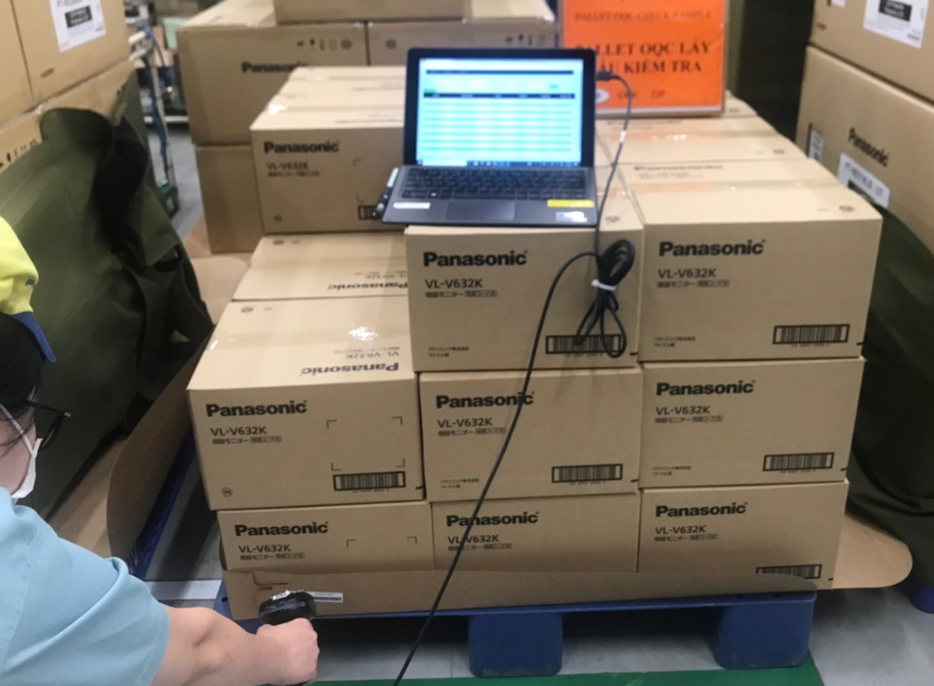
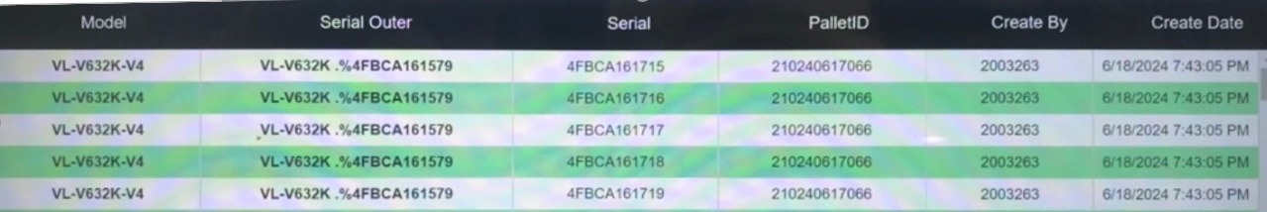
⑪~⑮ OQC chop stamp
13
Current chop stamp procedure
◆ Current
◆ Proposal
Current situation:
System auto indicate judgment lot
Finding pallet to confirm correct model, Q’ty
Indicate Judgment lot on system → All sections can understand lot situation
Eliminate physical chop stamp
OQC find Pallet ID
Matching ID Pallet and Outer Carton
OQC chop stamp all ID Pallet
Read ID Pallet & S/N carton box by excel file
Find all same model, production date, line, shift
Chop stamp on Pallet sheet
OK
DD-MM-YY
OQC
Using time:
DP/Dect: 480 mins/day
MW/TV/PJ/SB/PAPVN: 480mins/day
➔Save time: 960 mins/day ~ 2pax

Slide 14
Rule to Judge 1 LOT
14
Identify 1 lot:
There is another model to insert running while current model is running ➔ Switching model time is counted a new lot (Lot: Change another model or finish working shift)
Judgment 1 lot:
OQC will judge lot after finish inspection all sample Q'ty regardless of whether production has ended
1st sample
2nd sample
……
N sample
Final Judgment for Lot
OK
OK
OK
OK

Slide 15
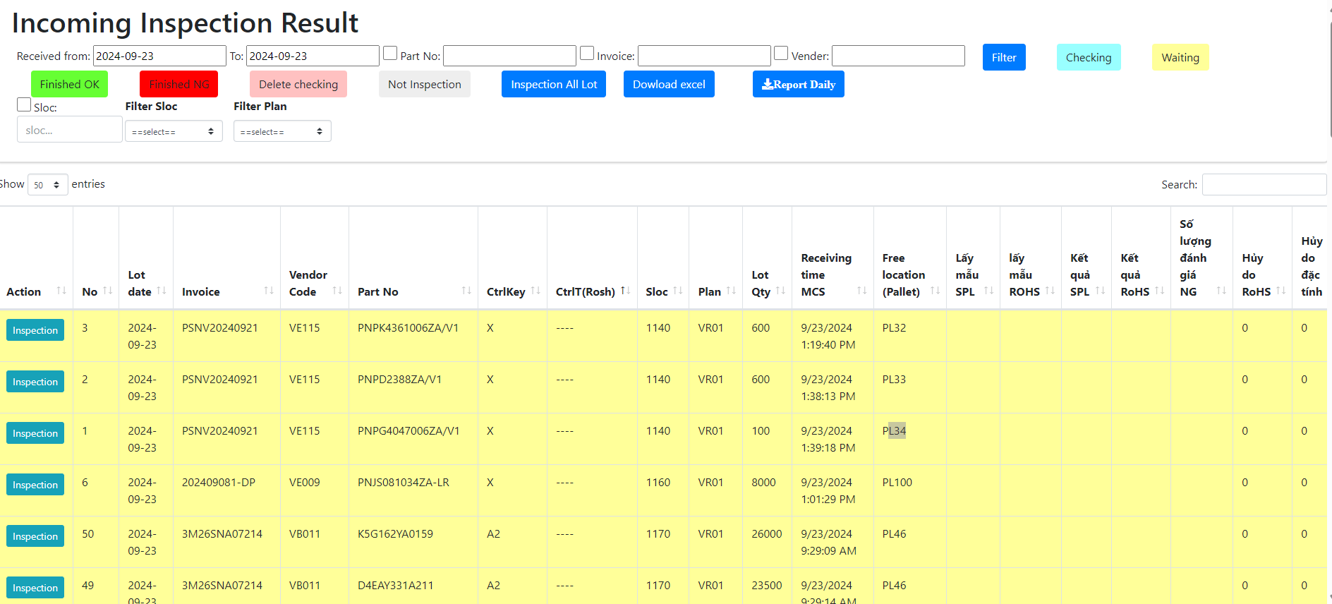
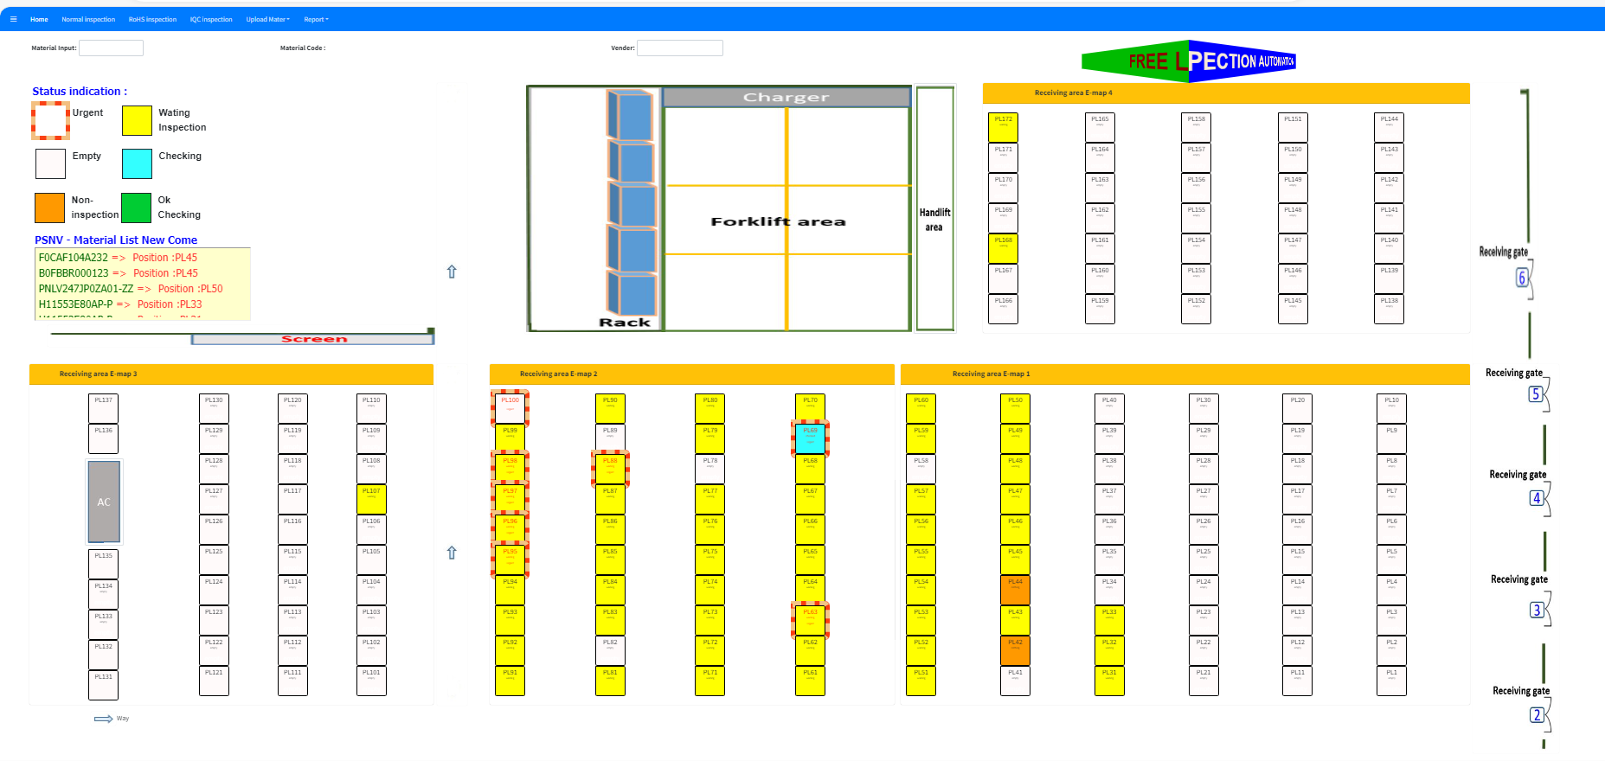
OQC DASH BOARD
15
Visualize status of Lot
Indication location at warehouse
Status situation
Not checked yet
Checking
Checking
<Can move pallet>
OK
NG
Not checked yet : OQC not taken sample yet
Checking : Under OQC checking
Checking : Under OQC checking (Sample Q’ty already checked over a half Q’ty of all sample)
<Can move pallet>
OK : All Lot judgment OK
NG : Lot judged NG
OQC inspection indication
Location indication at warehouse

Slide 16
Preparation Equipment for system
16
Equipment list up (OQC)
Cat/Equipment |  | DP/DECT | MW | PJ/SB | TV
Tablet (Connect with barcode reader) | Available (pcs) | 1 | 1 | 0 | 0
 | Additional (New) (pcs) | 1 | 0 | 1 | 1
➔ Need to add more 3pcs tablet

Slide 17


Proposal Procedure PCS → FA → OQC → SCM
17
Proposal procedure from PCS → FA → OQC → SCM
OQC pick up & Return sample
PCS issue Pro plan
Production plan
Pick up sample
Reading barcode Inner/Outer 1st
Weight check 1st
OQC Normal inspection
Reading barcode Product / Inner
Weight check 2nd
Reading barcode Inner/Outer 2nd
Return to Pallet
①
②
③
④
⑤
⑦
⑧
⑨
⑩
SCM shortage
FA confirm stock
Reliability
inspection
⑥
Auto judge Lot on system
Report daily
⑯
FA/SCM
FA
warehouse
FA
ID pallet
Scan ID pallet to receive by PDA
Confirm receiving by WMS
⑰
⑱
⑲
⑳
Merit:
OQC manual Job : Save 92 mins/day
OQC save man power : 2 pax

